Slide 1
Air Masses
9-9-19

Slide 2
North American Air masses
MENU

Slide 3
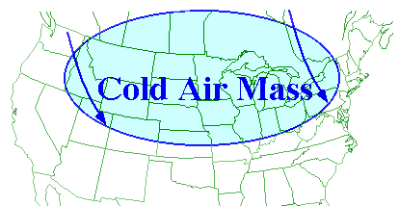
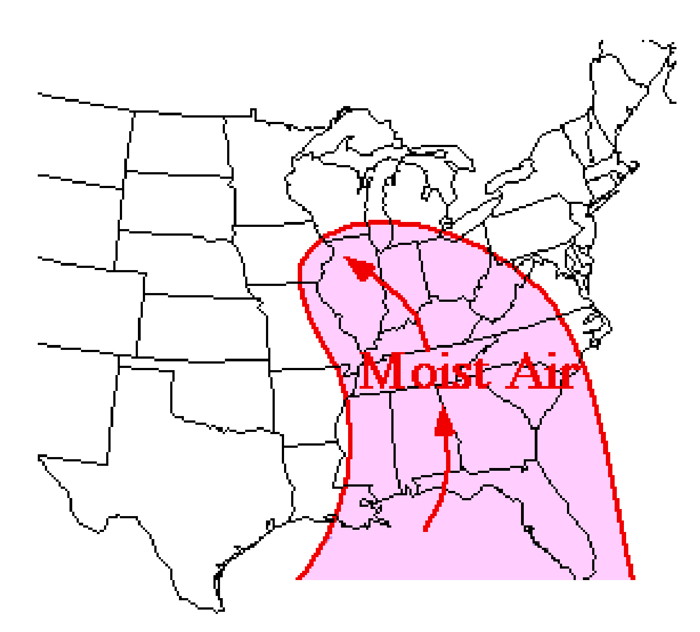
AIr Masses
There are two types of air masses:
1. Continental Polar air masses
2. Maritime Tropical air masses
MENU

Slide 4
Fronts
A front is the boundary separating air masses of different densities
Fronts extend both vertically and horizontally in the atmosphere
MENU

Slide 5
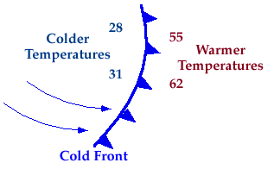
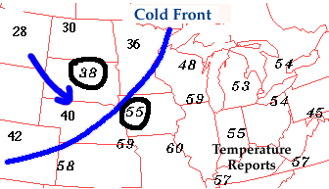
Cold Front
1. Cold Front: The zone where cold air is replacing warmer air
In U.S., cold fronts usually move from northwest to southeast
Air gets drier after a cold front moves through
MENU

Slide 6
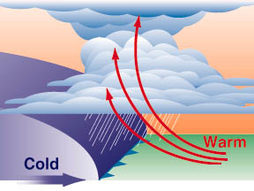
Cold Front
MENU

Slide 7
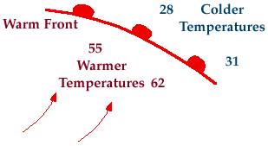
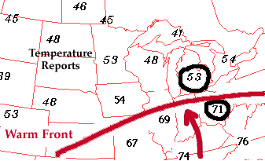
Warm Front
2. Warm Front: The zone where warm air is replacing colder air
In U.S., warm fronts usually move from southwest to northeast
Air gets more humid after a warm front moves through
MENU

Slide 8
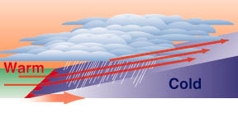
Warm Front
MENU

Slide 9
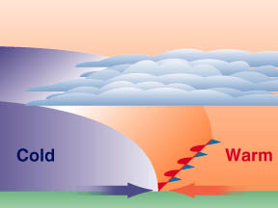
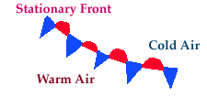
Stationary Front
3. Stationary Front: When either a cold or warm front stops moving
When the front starts moving again it returns to either being a cold or warm front
MENU

Slide 10
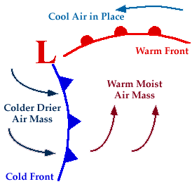
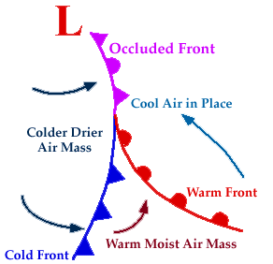
Occluded Front
4. Occluded Front: Formed when a cold front overtakes a warm front
This occurrence usually results in storms over an area
In U.S., the colder air usually lies to the west
MENU

Slide 11
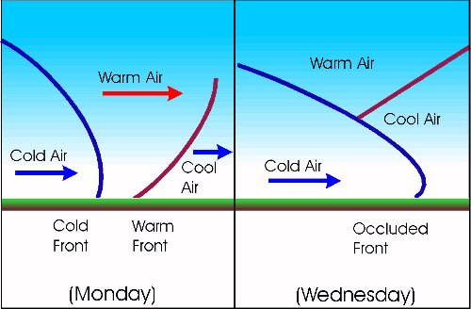
Occluded Front
MENU

Slide 12
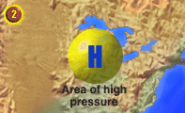
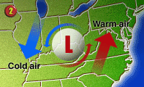
High & low pressure
High pressure causes air to sink
Usually results in several days of clear sunny skies
Air rises in low pressure areas and forms water droplets
Can results in rain and storms
MENU

Slide 13
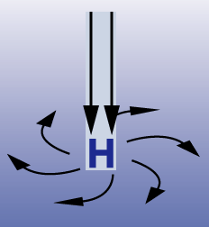
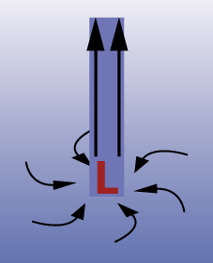
High & low pressure
High pressure systems usually signal more fair weather with winds circulating around the system in a clockwise direction.
Low pressure systems with counterclockwise circulating winds often result in rainy and/or stormy weather conditions.
HEAVY
LIFT
Highs & Lows Video 1:33
MENU

Slide 14
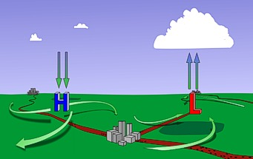
Low Pressure and Fronts Cause Lift

Slide 15
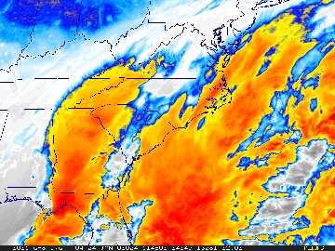
Low Pressure System
MENU

Slide 16
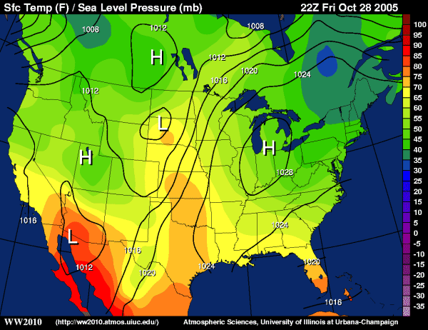
Weather Maps: Pressure & Temperature
MENU

